Slide 1
Project
Name : K.SUHITHA VANI
Reg No:24AFCSE363
College Name : Annamacharya University
Department : Computer Science and Engineering
Email : suhithavani@gmail.com
Mobile Number:9177065403
Project Name : AI Grammar Checker

Slide 2
AI Grammar Checker
Professional Project Presentation • Python
• Streamlit
• Groq

Slide 3
Problem Statement
• Correct grammar and improve English sentences using Artificial
Intelligence.
• Help users write clear, accurate and professional content.

Slide 4
Learning Objectives
• Understand text editing with AI.
• Learn prompt engineering.
• Integrate Groq LLM with Python.
• Develop interactive apps using Streamlit.

Slide 5
Technologies Used
• Python – Backend logic
• Streamlit – Web interface
• Groq – AI language model

Slide 6
System Architecture
• User Input
• Streamlit Interface
• Python Backend
• Groq API
• Corrected Output & Explanations

Slide 7
Features
• Grammar Correction
• Improved Writing
• Professional Rewrite
• Grammar Mistake Explanation

Slide 8
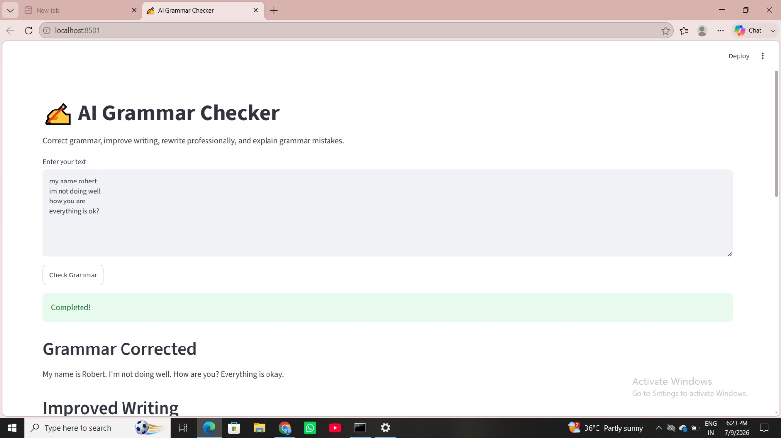
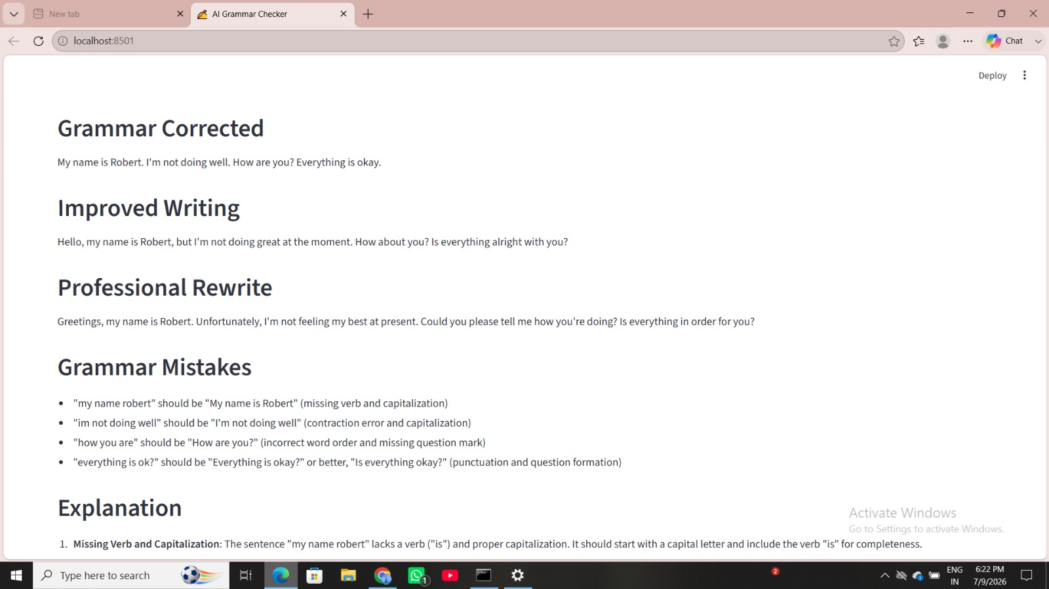
Workflow
• Enter text
• Prompt sent to Groq
• AI analyzes grammar
• Display corrected sentence, rewrite and explanations
Link : https://app-saeucsxhlw59g9hmkl9rt2.streamlit.app/
Screenshots:

Slide 9
Sample Input & Output
• Input: she don't know how to write a email.
• Output: She doesn't know how to write an email.
• Explanation: Subject–verb agreement, capitalization and article
usage corrected.

Slide 10
Advantages
• Fast and accurate
• Improves writing skills
• Easy to use
• Professional quality output

Slide 11
Future Enhancements
• Voice input
• PDF/DOCX support
• Multiple languages
• Writing score
• Download reports

Slide 12
Conclusion
• AI Grammar Checker enhances English writing by correcting grammar,
improving readability
and explaining mistakes using AI.

